Slide 1
Spot Nuclei, Speed Cure, Save Lives

Slide 2
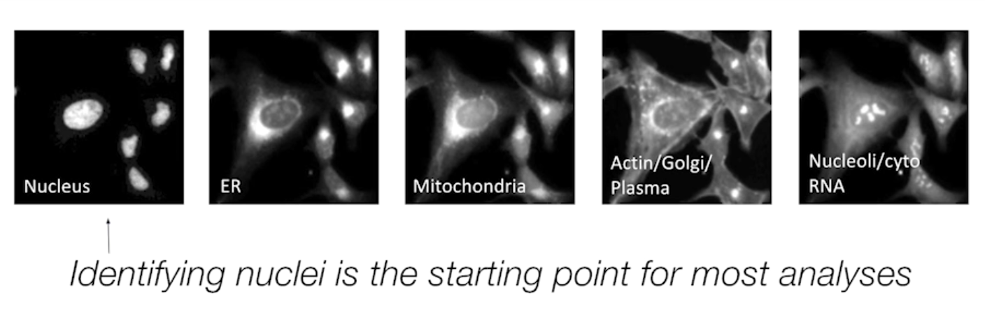
Introduction
Kaggle’s 2018 Data Science Bowl
Driven by a real need to develop new treatments faster and more accurately
Bottleneck in the search for effective medicine is finding nuclei in microscopy images
Why is finding the nuclei important to researchers?

Slide 3
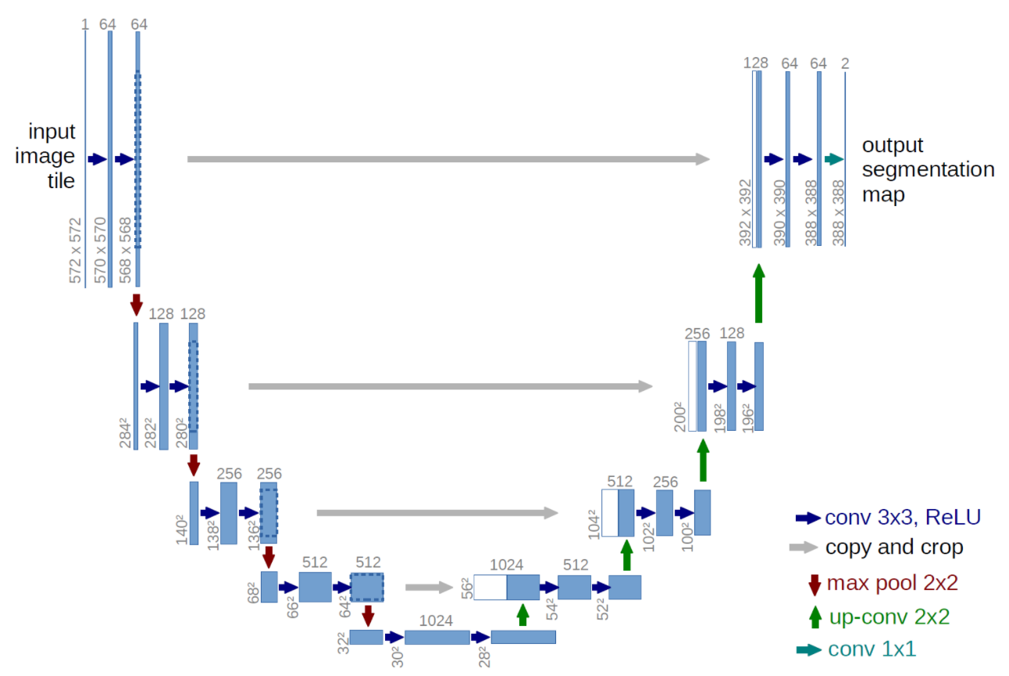

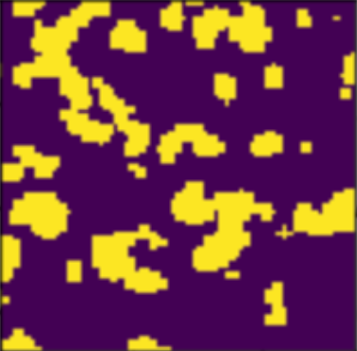
Proposed Approach: U-Net

Slide 4



Data Setup
Raw Training Image
Training Image Masks
Combined Mask

Slide 5
Experiment
Test #1: Open-Source U-Net framework from Github
Test #2: Using our own U-Net framework implemented with Tensorflow open-source machine learning libraries
Test #3: Preprocessing the images and using data augmentation to increase training dataset

Slide 6
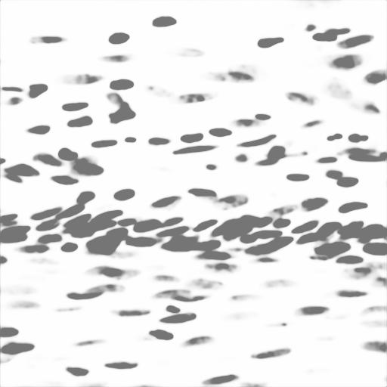
Evaluation (Test #1)
Training Image
Prediction

Slide 7

Evaluation (Test #1)
Training Image
Prediction

Slide 8
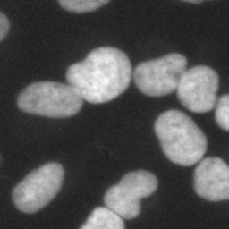

Evaluation (Test #2)
Training Image
Prediction

Slide 9
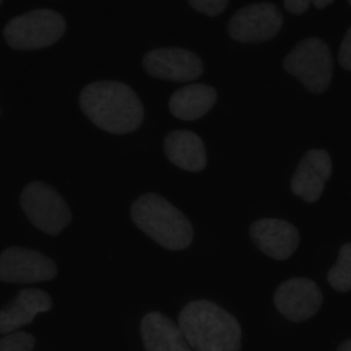
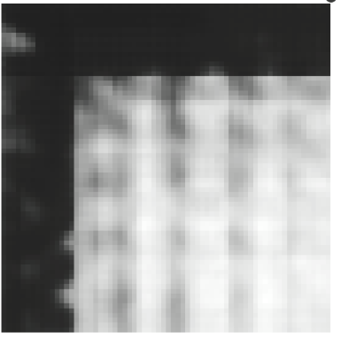
Evaluation (Test #3)
Training Image
Prediction

Slide 10
1. 2018 Data Science Bowl | Kaggle, www.kaggle.com/c/data-science-bowl-2018.
2. Maurer CRJ, Qi R, Raghavan V. A linear time algorithm for computing exact euclidean distance transforms of binary images in arbitrary dimensions. IEEE Trans. Pattern Anal. Mach. Intell. 2003 Feb;25(2):265–270
3. Ko B. C., Gim J.-W. & Nam J.-Y. Automatic white blood cell segmentation using stepwise merging rules and gradient vector flow snake. Micron 42, 695–705 (2011)
4. Bamford P. Unsupervised cell nucleus segmentation with active contours. Signal Processing 71, 203–213 (1998).
5. Wienert, Stephan et al. “Detection and Segmentation of Cell Nuclei in Virtual Microscopy Images: A Minimum-Model Approach.” Scientific Reports 2 (2012): 503. PMC. Web. 22 Feb. 2018.

Slide 11
Extra Slides

Slide 12
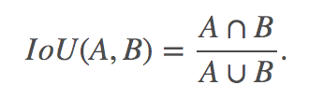
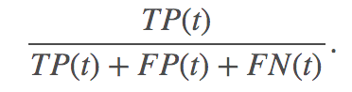
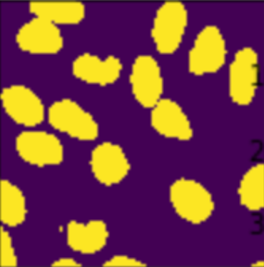
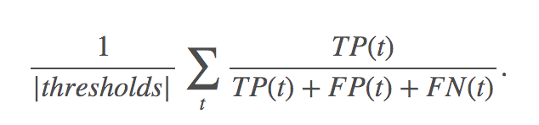
Evaluation: Mean Precision Across All Images
Calculate the intersection over union (IoU) of the proposed set of object pixels and set of true object pixels
At each threshold, a precision value gets calculated based on True Positive (TP), False Positive (FP), and False Negative (FN)
Average precision of an image is the mean of the precision value (calculated above) at each IoU threshold

Slide 13
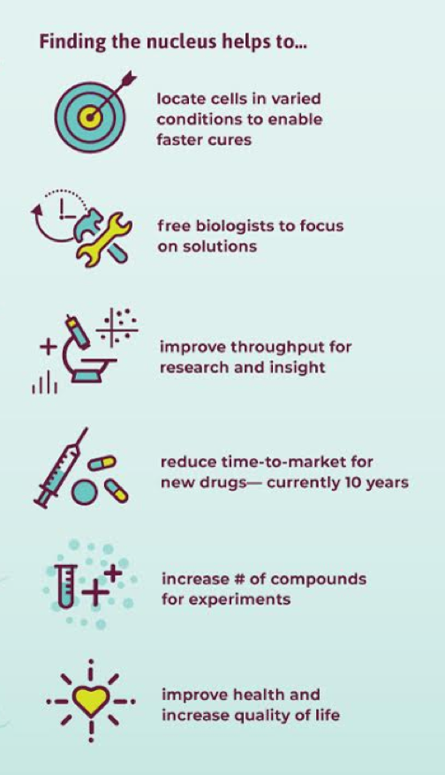
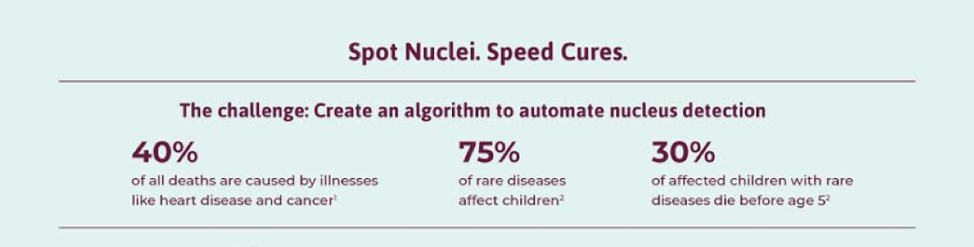
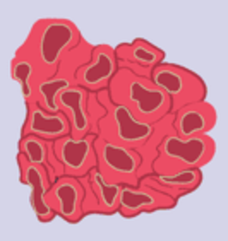

Motivations
New Chemical
Cancer Cells
Normal Cells

Slide 14
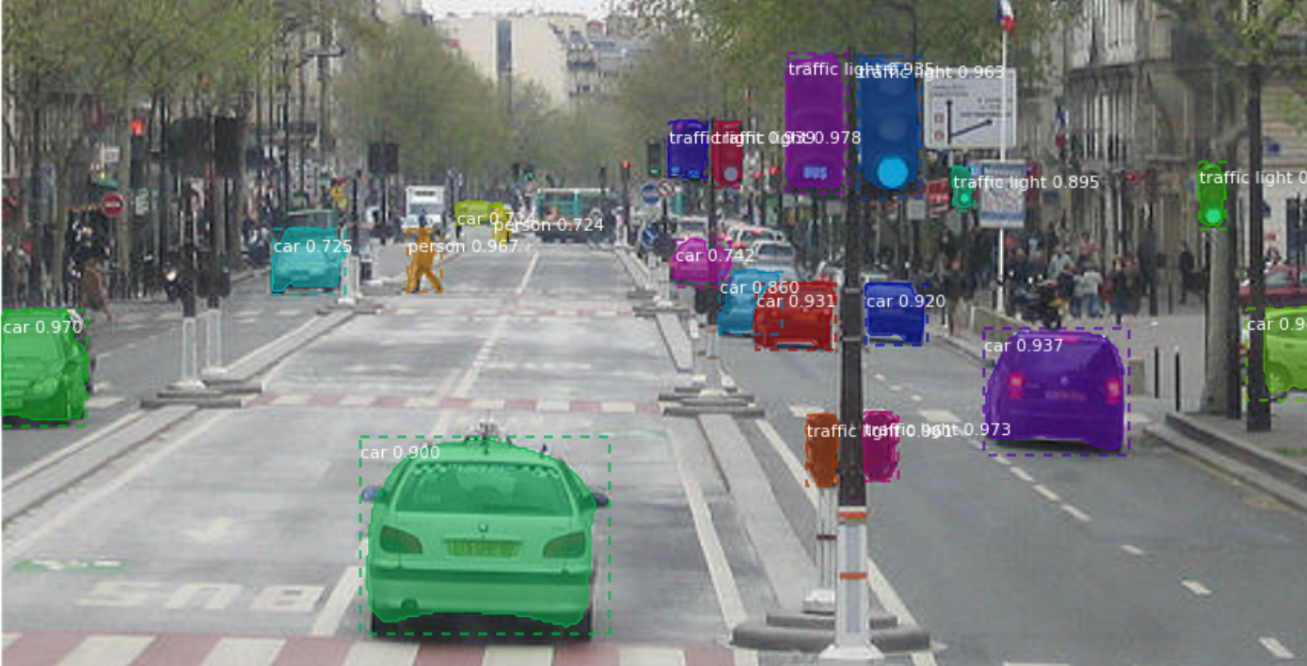
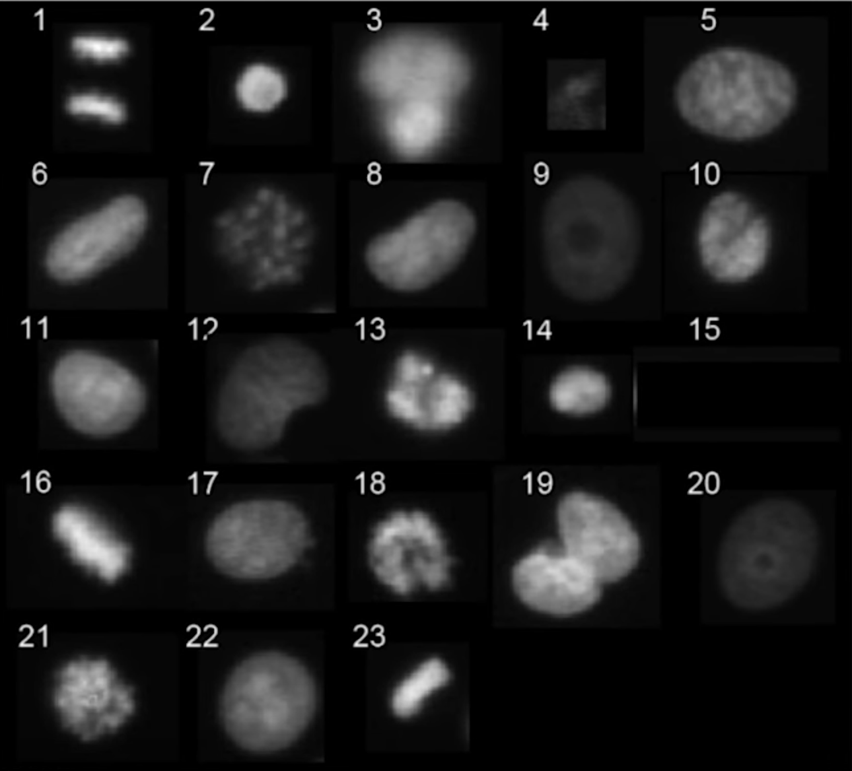
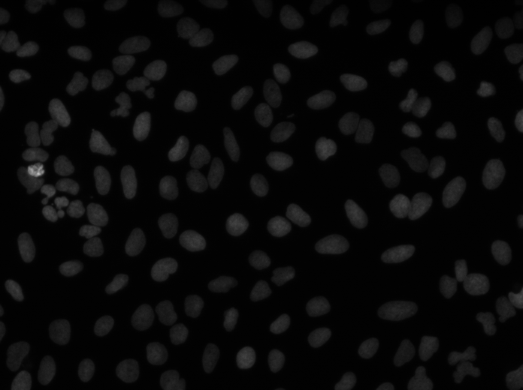
Related Works
Markers Detection
Instance Segmentation (Mask RCNN)
Build a generic model of the cell by using information about cellular feature

Slide 15
Timeline/Assignment
Assignment | Deadline
Research on high-level neural networks API and libraries | Feb 28
Learn about TensorFlow/python | Mar 7
Preprocess training data to use in U-Net | Mar 12
Develop training network | March 15
Develop loss function | March 19
Perform training and evaluation (Repeat) | TBA
Draft final report | TBA
Write final report | TBA

